Slide 1
WANTED!
Alive or alive

Slide 2
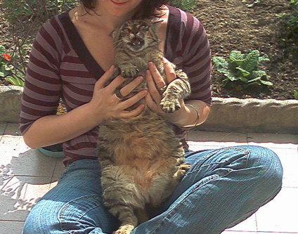
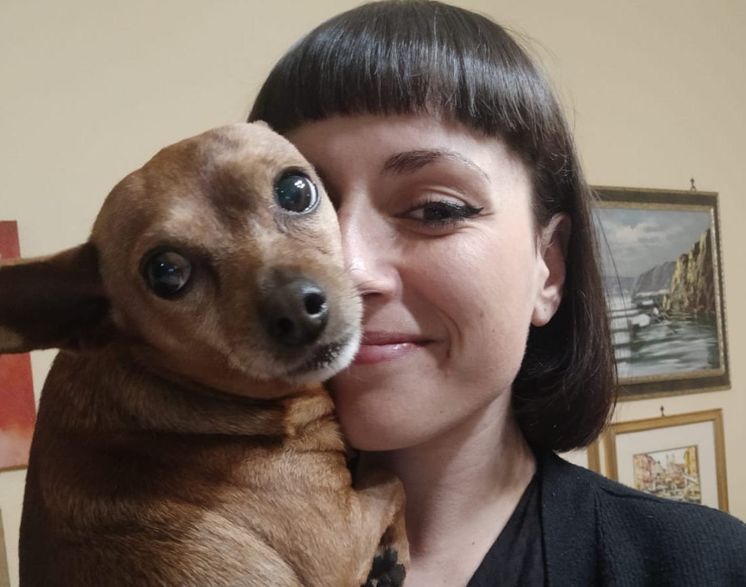
Team roles
ALISIA ZARBO – ENRICA ZANI
1° Year DHDK master degree
Digital Heritage and Multimedia course
Alisia Zarbo and Billy
Ideation cards museological approach; social media analysis; Personas; Scenarios with Twine; Virtual Frida's room with Blender; feasibility plan
Enrica Zani and Bigio
Basic idea and preliminary data section; physical museum analysis; Virtual Exibhition building with Omeka; application interaction diagram with Twine; mercandising ideation; privacy and copyright issues; bibliography

Slide 3
WANTED! > scaletta circa
The concept
The context analysis
Ideation cards
Museological approach
Personas and scenarios
Intro
The website
In Art – The Exhibit
3d Frida room
Choose yout Guide!
Evaluation form
Share your story
Merchandising
Forthcoming app
Preliminary data and Inspiration
Notes:
ugly duckling

Slide 4
WANTED! Alive or alive
Wanted! is a project that have been inspired by a corpus of lost-pets-advertisements photographs, collected by the authors over the years in various places.
It is focused on the complex relationship between humans and their pets in an anti-speciesist view of interpersonal relationship and family binds.
The name Wanted! comes from the strong visual relationship of these SOS-flyers with the Old West bandit bans even if, like the subtitle “Alive or Alive” explains, with different and opposite purposes and intents.
Notes:
ugly duckling

Slide 5
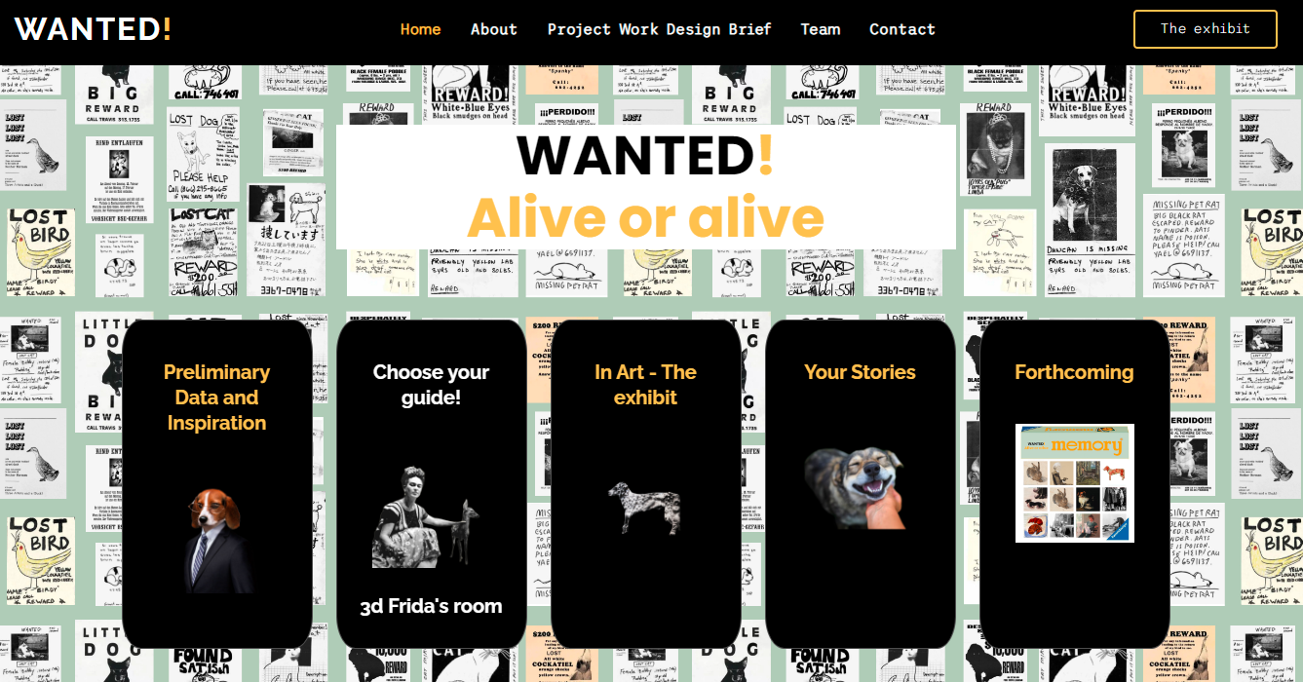
WANTED!
a growing souvenir-book built from users’ stories in the Your Stories section;
The website
The website https://enri-ca.github.io/WANTED/, is conceived as a multi-dimensional cultural environment offering different paths to be explored:
a Preliminary Data and Inspiration section to access data – such as the already mentioned corpus of lost-pets-advertisements photographs - analysed to realize the project;
a current virtual exhibition and its related interactive applications in the In Art – The Exhibit and Choose your guide and 3d Frida's room sections;
a preview of the developments in the Forthcoming section
Notes:
ugly duckling

Slide 6
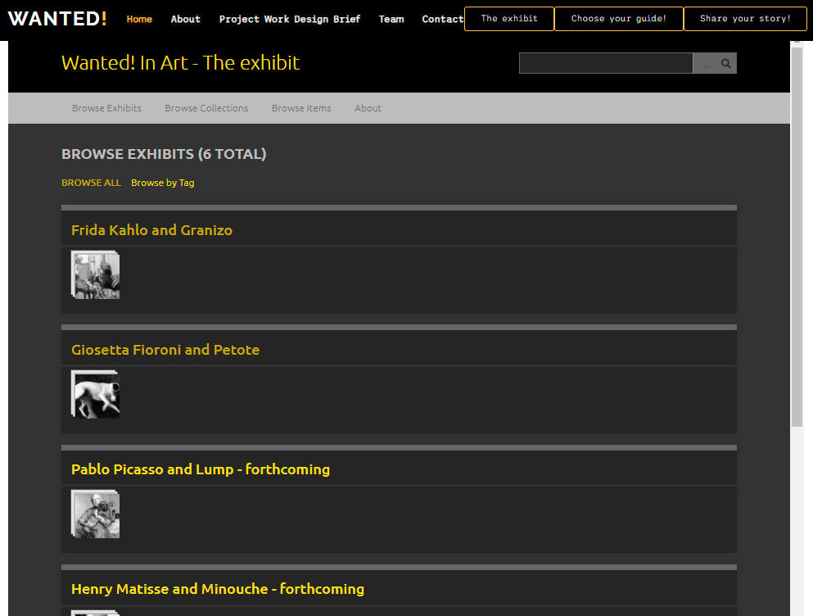
In Art – The exhibit
Virtual Exhibition
A virtual exhibition on the relationship of some artists and their pets:
6 artist’s paths:
Frida Kahlo and Granizo, Giosetta Fioroni and Petote (realized);
Pablo Picasso and Lump, Henry Matisse and Minouche, Salvador Dalí and Babou (forhcoming)
Tool: Omeka.net
Database of heterogeneous cultural objects, held by different institutions
DC description
Useful tool for museological paths
Notes:
ugly duckling

Slide 7
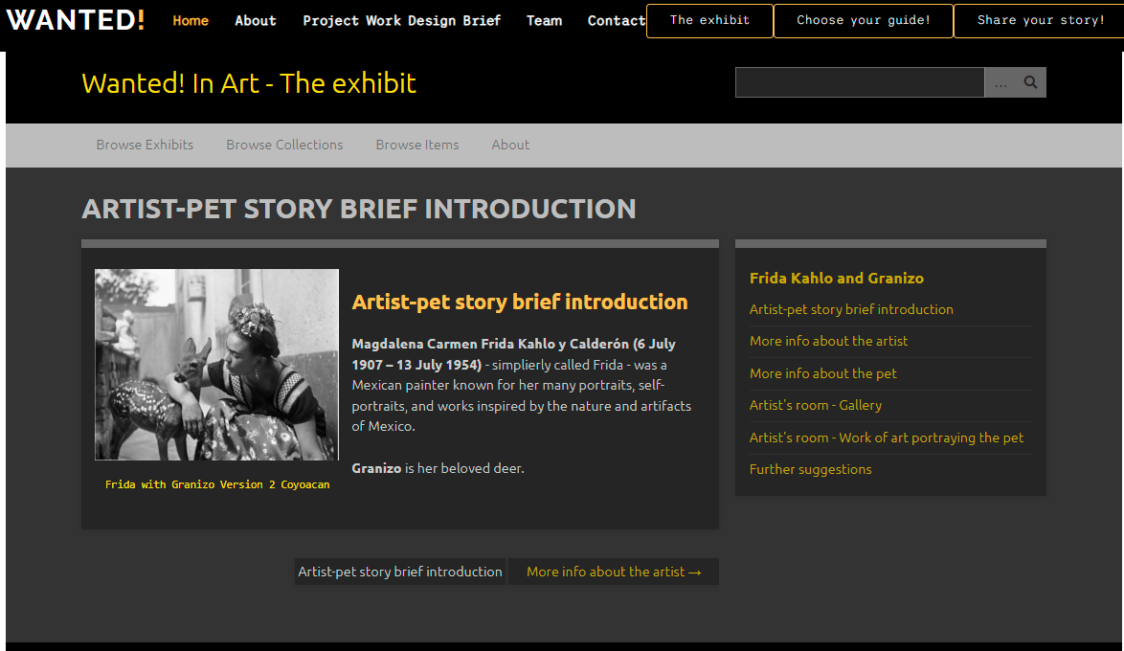
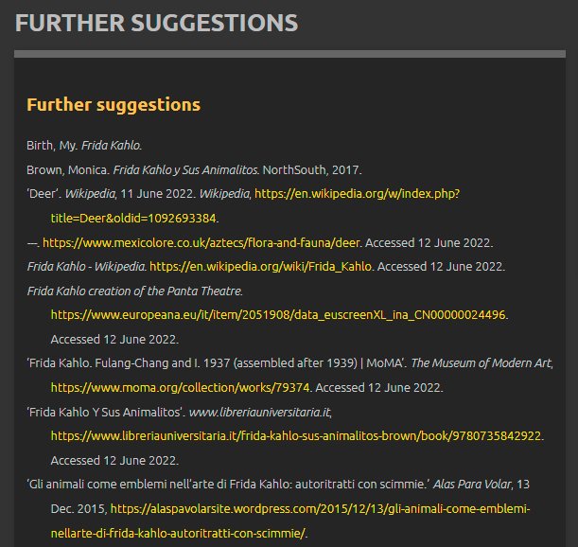
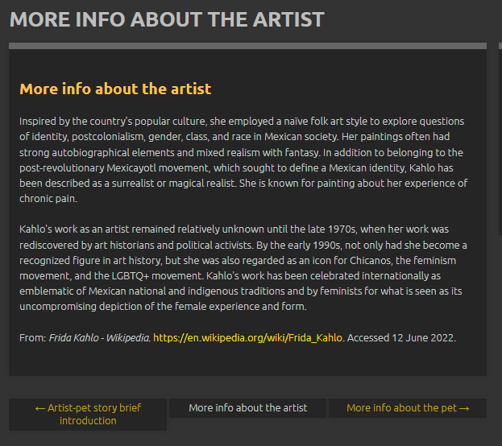
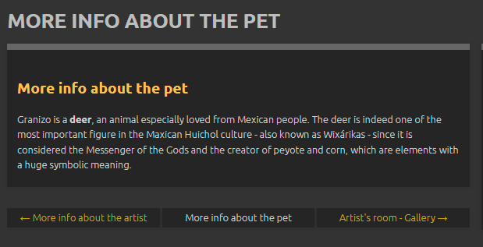
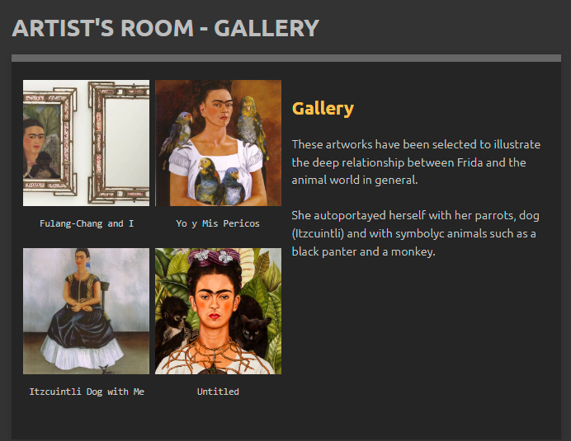
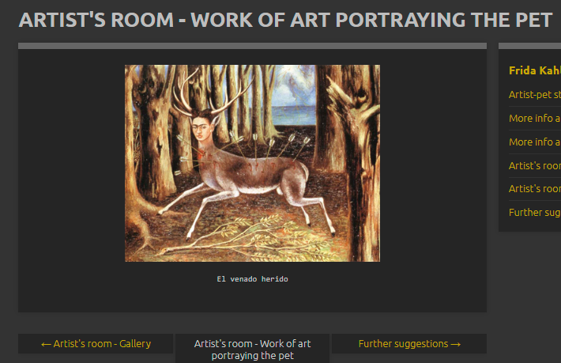
In Art – The exhibit
Virtual Exhibition
A virtual exhibition on the relationship of some artists and their pets:
6 ….erogeneous cultural objects, held by different institutions
DC description
Useful tool for museological paths
Notes:
ugly duckling

Slide 8
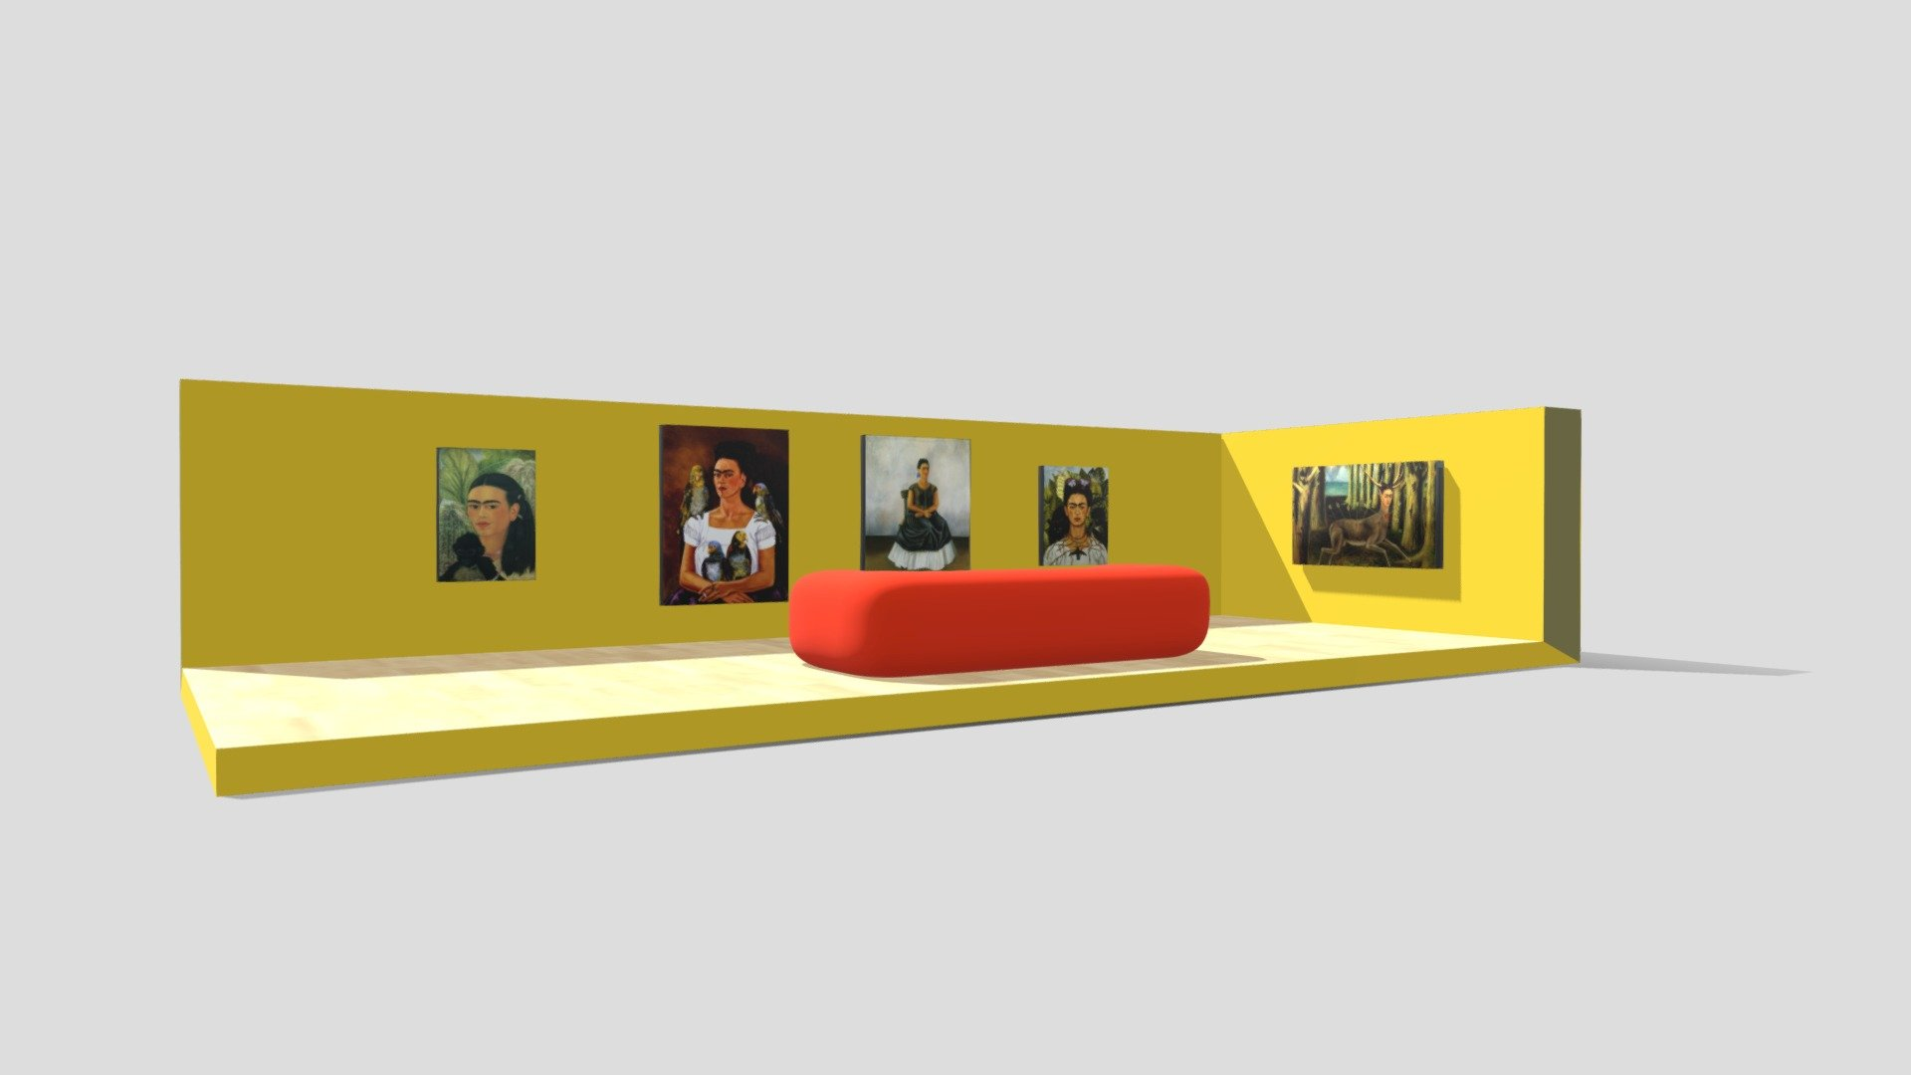
3d Frida’s room
Complementary material

Slide 9
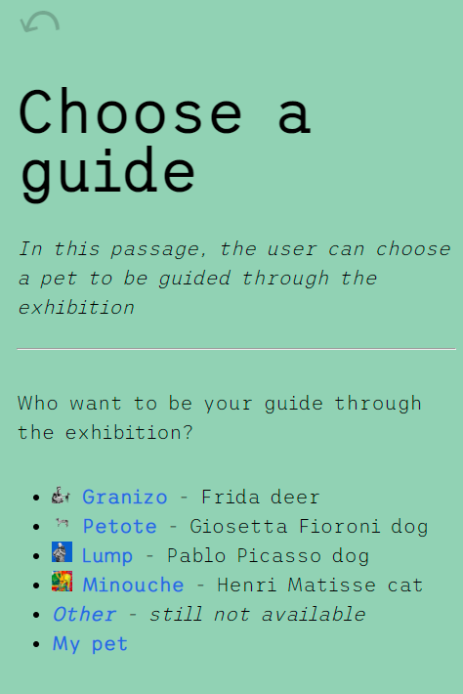
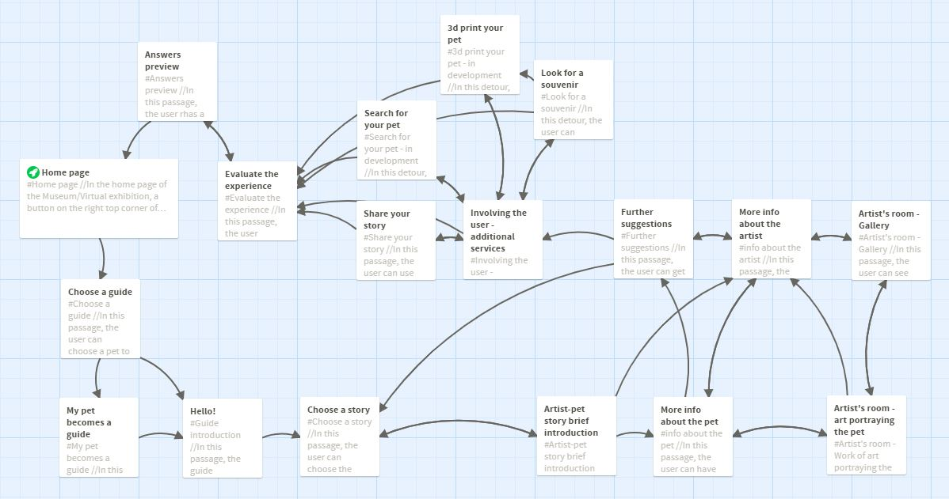
Choose your Guide!
Interacttive application
Notes:
ugly duckling

Slide 10
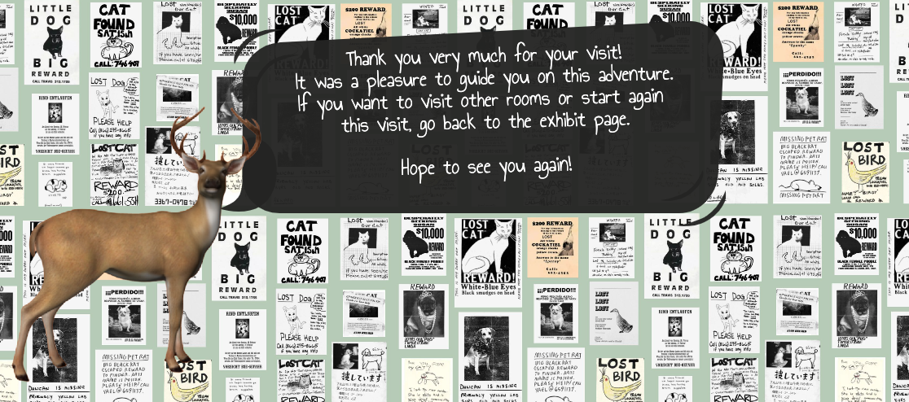
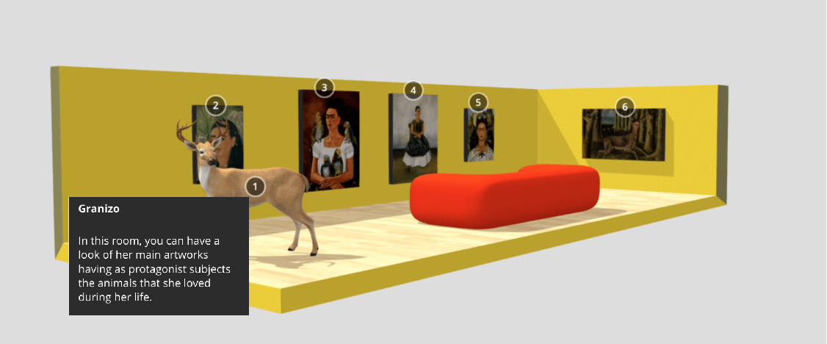
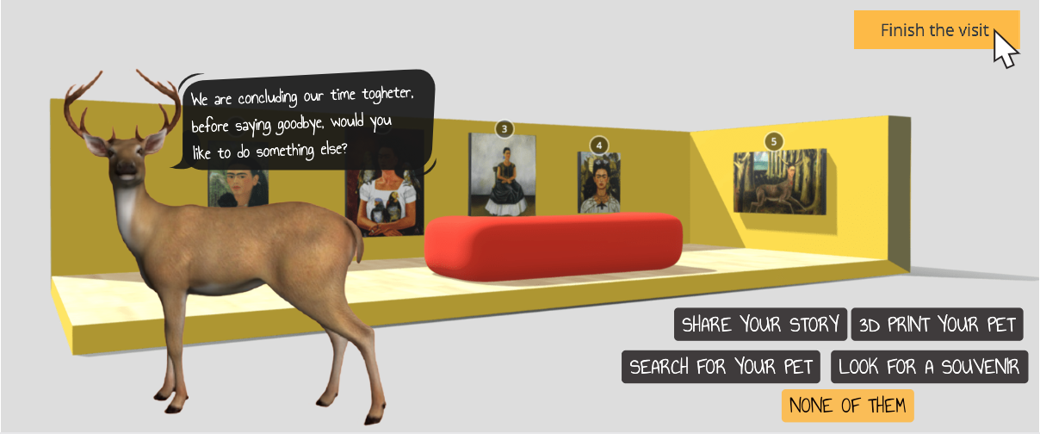
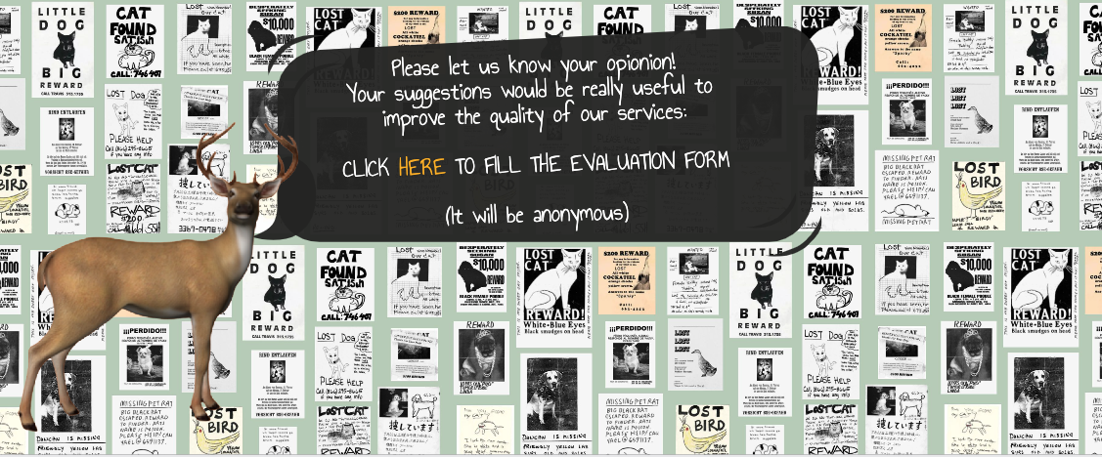
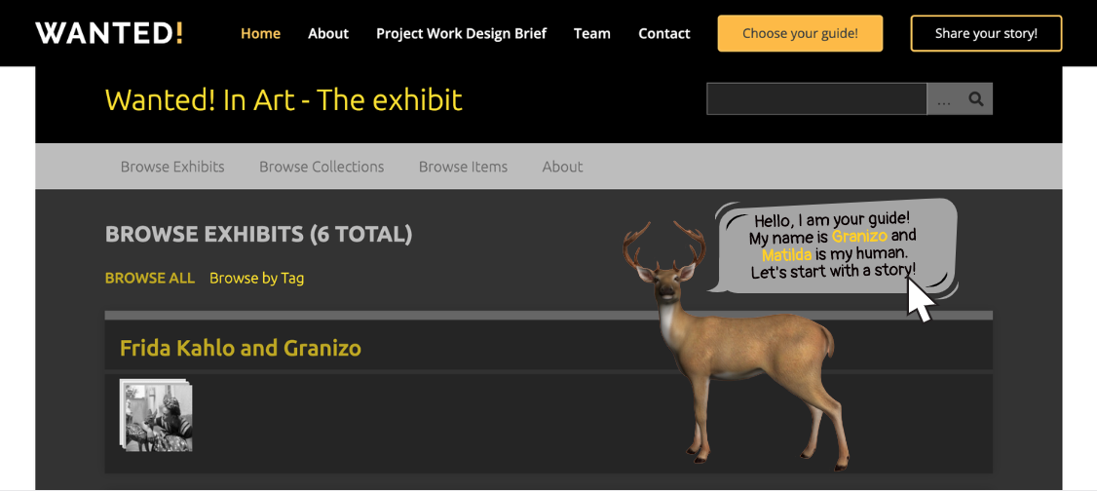
Interacttive application
Choose your Guide!

Slide 11
Evaluation
Did you like the guide you have choosen?
How useful have been the contents you were told?
How much did you appreciated the final services offered ("Share your story", "3d print your pet", "Search for your pet")?
Overall, how much did yoy like the interactive experience?
Would you recommend this experience to other?
Free comments/suggestions/complains

Slide 12
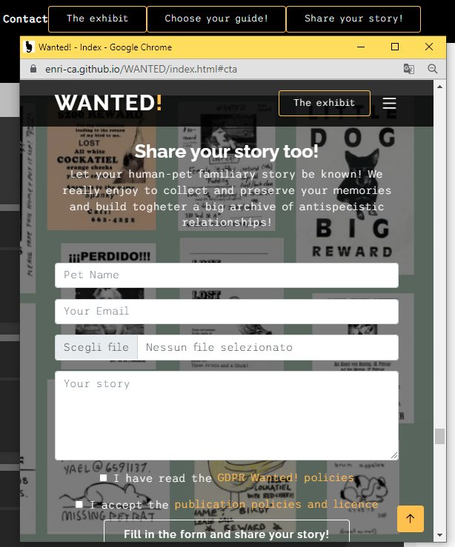
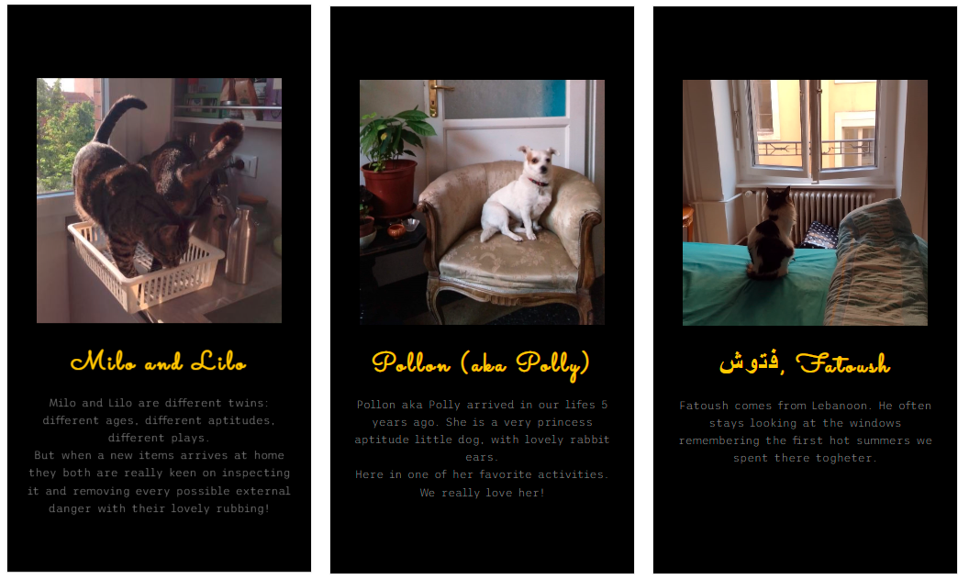
Engaging user
Share your story!

Slide 13
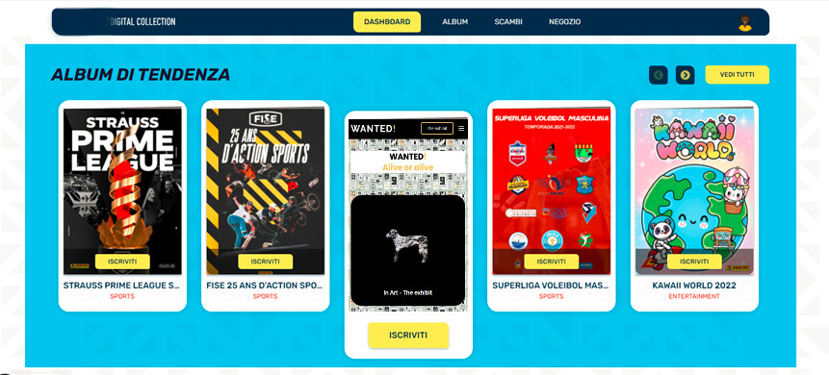
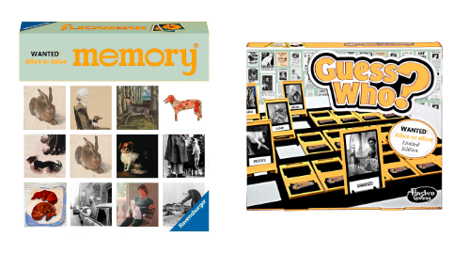
Engaging user
Merchandisign

Slide 14
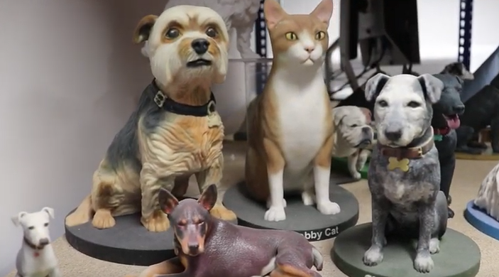
Engaging user
Forthcoming applications
3d print your pet
The idea is to develop a tool to realize a 3d printed little modelling of our pet, starting from uploading a 360° video. The merchandising unit will be in charge to realize and send home to the users the realized 3d print that will be used as a gift or a little celebrating statue.

Slide 15
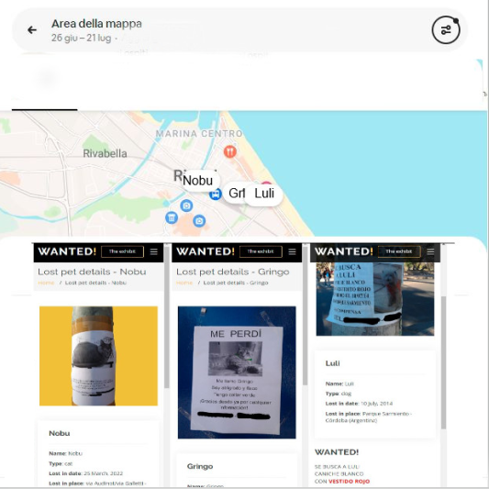
Engaging user
Forthcoming applications
Search for your pet!
Search for your pet is a tool able to help people who lost their pets by loading, sharing, and visualizing geolocated data of their missing pets. The user will have the possibility to fill in a form that will structure data similarly to those seen in the Preliminary data section; other users could improve information in case they have seen the lost-pet.

Slide 16
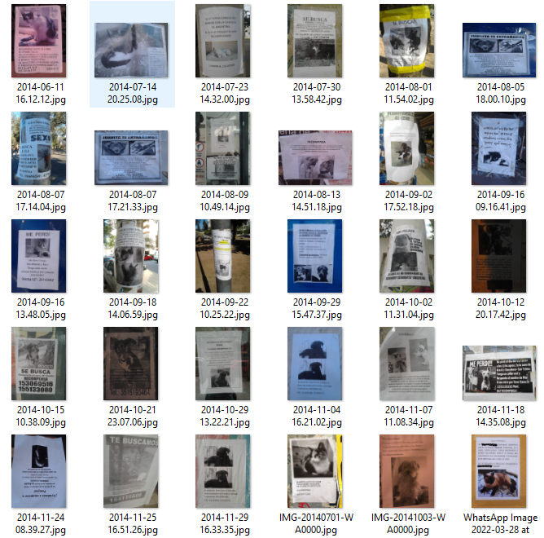
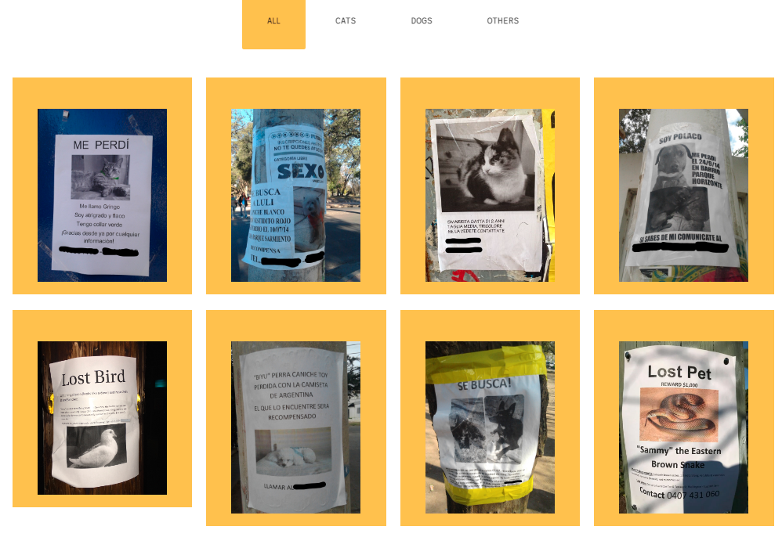
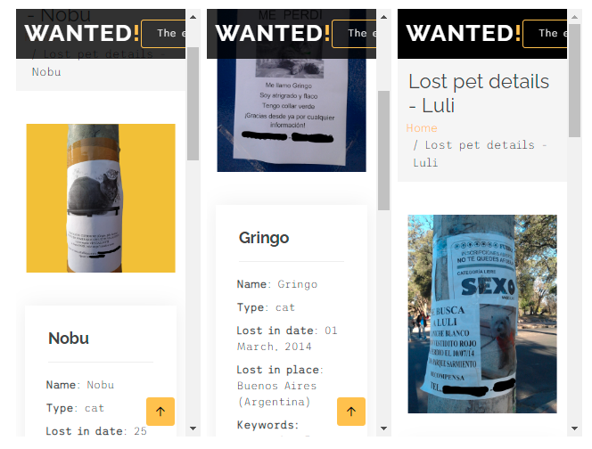
Preliminary data
Preliminary data and Inspiration

Slide 17
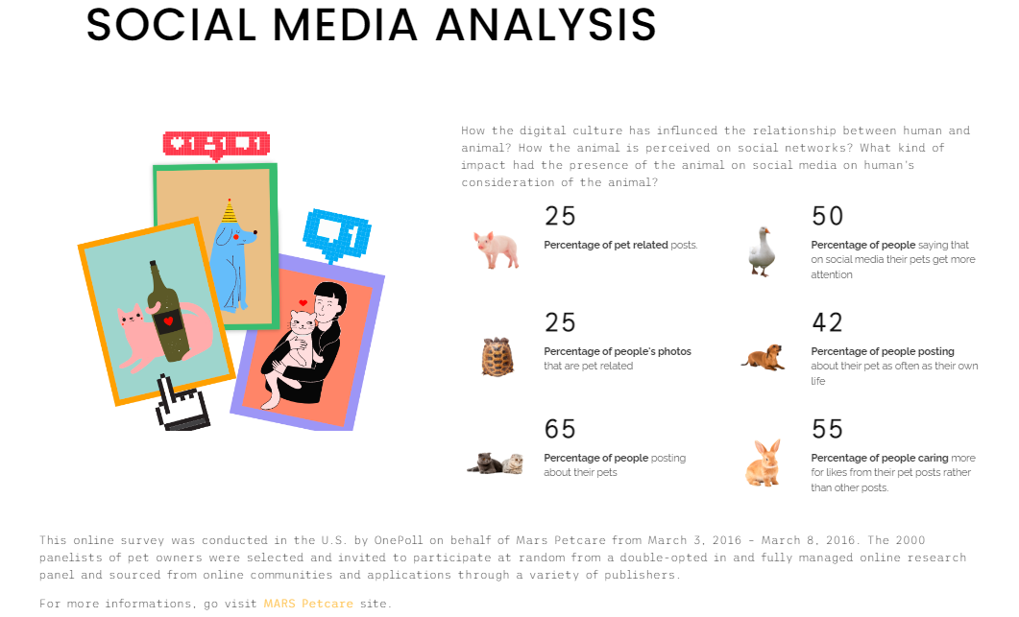
Preliminary data and Inspiration

Slide 18
How we arrive to define this project?
Context
Design cards
Goals
Museological approach
Personae
Scenarios

Slide 19
1. Preliminary brainstorming Corpus of lost-pets advertisements
Our starting point has been a corpus of photographs taken during the years in different places.
We were interested in these characteristics:
1. standard pattern of the visual construction
2. affective tie between the lost animals and their owners
3. power expressivity of the words used to describe the physical or behavioural features of the pet
4. personalization of the standard pattern/basic greyprint to give detaching details
Personas
Notes:
ugly duckling

Slide 20
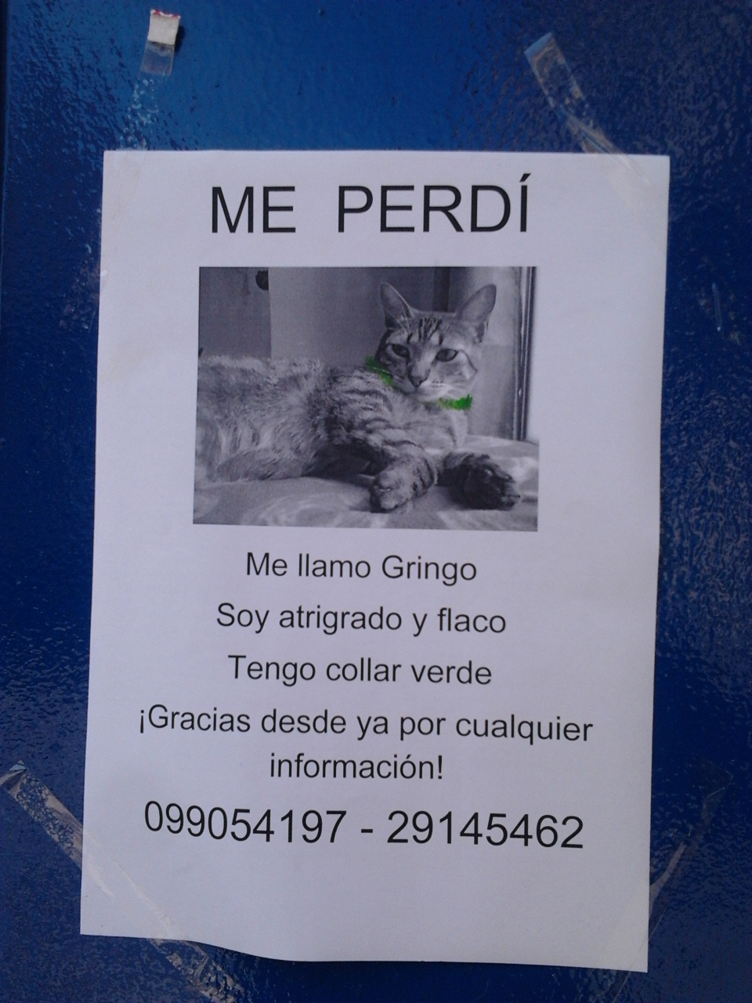
1. Preliminary brainstorming Corpus of lost-pets advertisements. Ex. 1
Our starting point has been a corpus of photographs taken during the years in different places.
We were interested in these characteristics:
1. standard pattern of the visual construction
2. affective tie between the lost animals and their owners
3. power expressivity of the words used to describe the physical or behavioural features of the pet
4. personalization of the standard pattern/basic greyprint to give detaching details
Notes:
ugly duckling

Slide 21
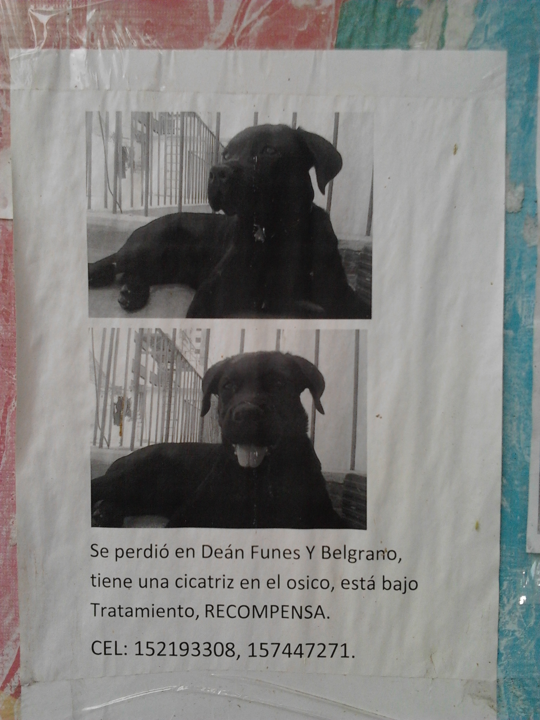
1. Preliminary brainstorming Corpus of lost-pets advertisements. Ex. 2
Our starting point has been a corpus of photographs taken during the years in different places.
We were interested in these characteristics:
1. standard pattern of the visual construction
2. affective tie between the lost animals and their owners
3. power expressivity of the words used to describe the physical or behavioural features of the pet
4. personalization of the standard pattern/basic greyprint to give detaching details
Notes:
ugly duckling

Slide 22
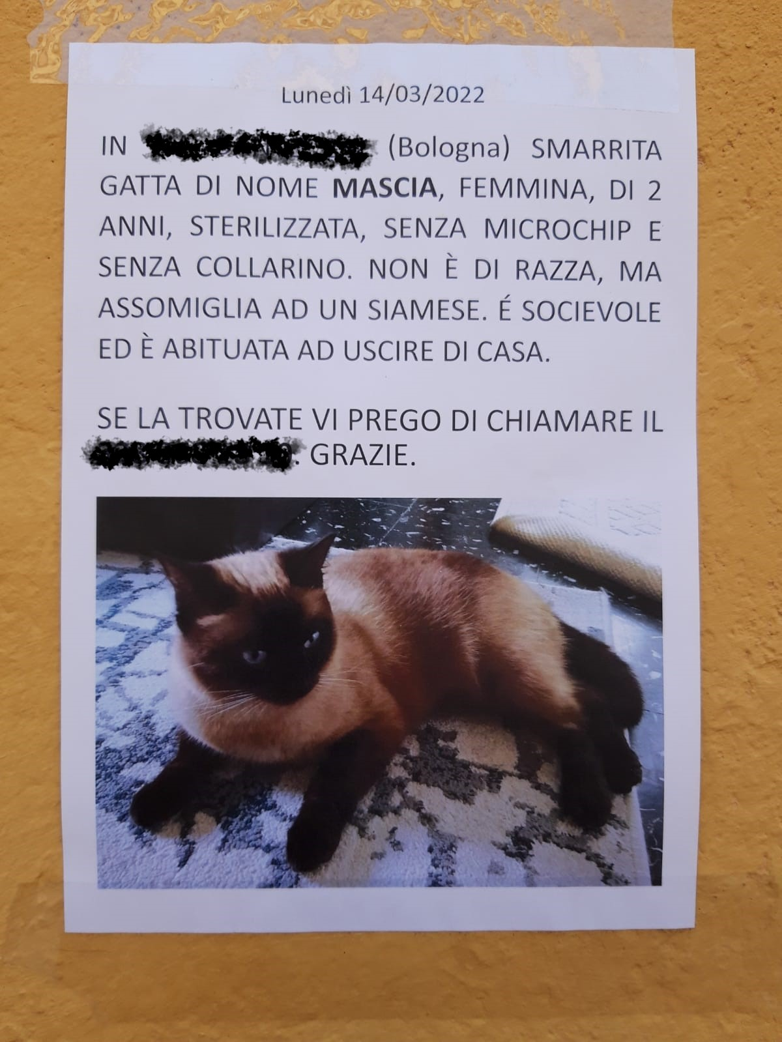
1. Preliminary brainstorming Corpus of lost-pets advertisements. Ex. 3
Our starting point has been a corpus of photographs taken during the years in different places.
We were interested in these characteristics:
1. standard pattern of the visual construction
2. affective tie between the lost animals and their owners
3. power expressivity of the words used to describe the physical or behavioural features of the pet
4. personalization of the standard pattern/basic greyprint to give detaching details
Notes:
ugly duckling

Slide 23
Benchmark on human-pet relation cultural institutions
We then started searching for cultural institutions devoted to the happier theme of human-pet relationship
We did a short and really lazy google search on «cat museum» keywords and use this offered result between the first 10 «17 Dog and Cat Museums Around the World»
Analyzing the 17 museums presented we find some recursive caracheristics as:
A lot of single-pet celebrating institutions
Run by private fundations or individual passionated
Often not technologically updated
Really devoted to passionated and amateurs target
Lack of high museographic standards
Lack of overall insitutions about anti-specistic view of interpersonal relationship and family's bounds
Scientific institutions e.i. Collezione di Anatomia degli Animali Domestici dell’Università di Bologna
Notes:
ugly duckling

Slide 24
Real Cat museum(s)
The Cat Cabinet was founded in commemoration of the ginger cat John Pierpont Morgan (1966-1983). This special cat was the stubborn, headstrong companion of the museum's founder, Bob Meijer.
The museum is housed in the impressive, classically-furnished first floor - or piano nobile - which contains five rooms and is itself an attraction.
We choose as example the KattenKabinet (Cat Cabinet)
https://www.kattenkabinet.nl/
https://www.facebook.com/CatCabinet/
https://www.instagram.com/het.kattenkabinet/
Herengracht 497, 1017 BT Amsterdam The Netherlands
Tuesday to Sunday from 12:00-17:00
Context
The collection of the Cat Cabinet offers a wide look at the role of the cat in art and in culture through the centuries.
Neighborhood: Centrum
Amsterdam’s buzzing hub, with its sprawling network of tram rails and a seemingly constant flow of tourists and commuters, yields convenient access to some of the best sightseeing, shopping, and street life in Europe. Closest at hand are the Royal Palace, the quaint shops of Haalremmerdijk, the pedestrianized zones Kalverstraat and Dam Square with popular neighborhoods such as the Red Light District, and the Canal Ring hardly more than a moment’s stroll away. With the well-connected Centraal Station as Centrum’s base, it's easy to travel farther afield via one of the city’s iconic trams. (from https://www.tripadvisor.com/Attraction_Review-g188590-d196104-Reviews-The_Cat_Cabinet-Amsterdam_North_Holland_Province.html)
Notes:
ugly duckling

Slide 25
Real Cat museum(s)
We choose as example the KattenKabinet (Cat Cabinet)
Star Assets
Location
Art collection
Attention to interaction (early Virtual tour in flash)
Audience
Passionated and amateurs target
Art historian …
General tourist
Institutional goals
Renewal the communication and website
Attract new audience
Survive the fundator
Notes:
ugly duckling

Slide 26
2. Two case study Virtual exposition on artists-pets relationships
For a
Analyzing
then started
Star Assets:
…. …
…
Audience
Institutional goals
Motivations
Barriers
Capabilities
Devices
Notes:
ugly duckling

Slide 27
Ideation cards for VE

Slide 28
Museological approaches

Slide 29
Personas and scenario

Slide 30
4. Bibliography
https://enri-ca.github.io/WANTED/4.html#
Notes:
ugly duckling

Slide 31
Thank you for your attention!

